Slide 1
2022 HECSE Winter Summit
Office of Special Education Programs
U.S Department of Education
February 18, 2022

Slide 2
Personnel Development Program
Brief Updates & Resources
Sarah Allen & Celia Rosenquist

Slide 3
Personnel Development Program
Brief Updates & Resources
Help address State identified needs for qualified personnel -in special education, early intervention, related services, and regular education- to work with children with disabilities; and
Ensure that those personnel have the necessary skills and knowledge, derived from practices that have been determined through scientifically-based research and experience, to be successful in serving those children
Current PDP Investments
Planned PDP Investments
Useful Resources

Slide 4
Secretary’s Supplemental Priorities
SECTRETARY’S SUPPLEMENTAL PRIORITIES
Priority 3 – Ensuring a Diverse Education Workforce and Professional Growth To Strengthen Student Learning
Priority 6 – Strengthening Cross-Agency Coordination and Community Engagement to Advance Systemic Change
Priorities 1, 2, 4 & 5 –
Final Priorities and Definitions- Secretary’s Supplemental Priorities
and Definitions for Discretionary Grants Programs
Notes:
https://www.govinfo.gov/content/pkg/FR-2021-12-10/pdf/2021-26615.pdf

Slide 5
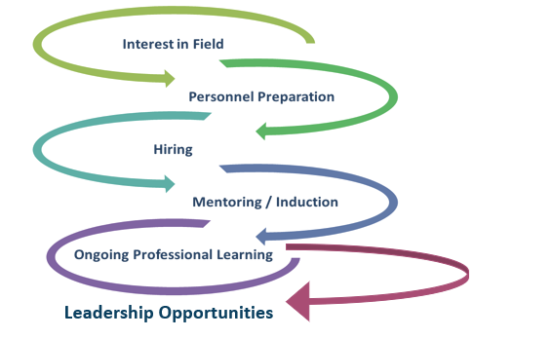
STRATEGIC INVESTMENTS Across the Career Span
STRATEGIC INVESTMENTS
Across the Career Span

Slide 6
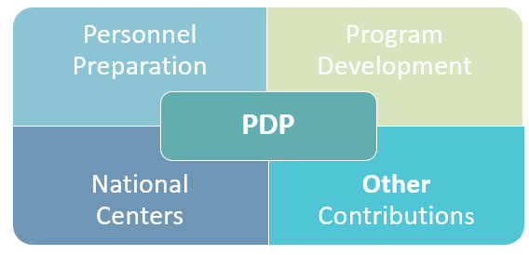
CURRENT PROGRAM INVESTMENTS
CURRENT PROGRAM INVESTMENTS
325K
325D
325H
CEEDAR
ECPC
IRIS
325L
325N
325P
Deaf/Blind
PDPDCS
CIPP

Slide 7
84.325P
Improving Retention of Special Education Teachers and Early Intervention Personnel
FY 2020 Awards (3)
Connecticut (C)
Georgia (B)
Texas (B)
__________________________
FY 2021 Awards (6)
Colorado (B)
Federated States of Micronesia (B)
Marshall Islands (B)
Maine (B)
Virginia (B)
Washington (B)
Purpose—To support SEAs and Lead Agencies to develop or expand, implement, evaluate, and sustain comprehensive retention plans to retain special education teachers and early intervention personnel
Features of the Priority —
  Partner with IHEs, LEAs or EI Service Providers, PTIs and Other Key Stakeholders
  Use Administrative Data to Inform Decisions
  Program Planning Year
  Evidence-Based Policies and Practices

Slide 8
84.325L
Leadership Development Program: Building the Capacity of Leaders to Improve Systems Serving Children with Disabilities
Purpose—To support SEAs and Lead agencies to develop or expand, implement, evaluate, and sustain leadership development programs for administers of systems serving children with disabilities.
Key Features of the Priority—
  Coursework
  Applied Projects
  Coaching / Mentoring
  Network of Peers
  IHE Partners
FY 2020 (6)
Ohio (C)
Georgia (B&C)
Federated States of Micronesia (B)
Kentucky (B)
Nebraska (B)
Washington (B)
FY 2019 (4)
Connecticut (C)
Delaware (B)
Louisiana (B)
Missouri (B)

Slide 9
84.325K – FY 2021
  Interdisciplinary Preparation of Special Education, Early Intervention, and Related Services Personnel Serving Children with Disabilities Who Have High-Intensity Needs
Purpose—To prepare practitioner-level personnel in
special education, early intervention, or related services who have the knowledge and skills to use EBPs to improve
results of infants, toddlers, children with disabilities
Key Features of the Priority
  Future Faculty / Administrators
  Research, Teaching, Policy, Service
  Scholar accomplishments
Competitive Preference Priorities—
  Novice
  Preparing Non-Traditional Scholars
Evidence-based Practice Areas Addressed:
Assessment
Behavior
Inclusive Strategies
Instructional Practices
Literacy / Numeracy
Notes:
In FY 2021, we funded 38 new awards including 12 under Focus Area A (Early Childhood) and 26 under Focus Area B (K-12)

Slide 10
84.325K – FY 2022
Notice Inviting Applications
February 4, 2022
Deadline: April 15, 2022
  Preparation of Special Education, Early Intervention, and Related Services Personnel Serving Children with Disabilities
Purpose—To prepare practitioner-level personnel –in special education, early intervention, or related services- who have the knowledge and skills to use EBPs to improve results of infants, toddlers, children and youth with disabilities
Absolute Priority 1— Interdisciplinary Preparation of Personnel Serving CWD who have High-Intensity Needs
at master’s, educational specialist, or clinical doctoral degree levels
Absolute Priority 2— Preparation of Personnel
Attending MSIs* at certification, bachelor’s, master’s,
educational specialist or clinical doctoral degree levels
  NOTE: *Minority enrollment of 50 percent or more
Notes:
https://www.govinfo.gov/content/pkg/FR-2022-02-04/pdf/2022-02392.pdf
Based on current budget information, $9.6M is proposed for the estimated number of new awards at 38.
Both Absolute Priority (AP) 1 and AP 2 will fund awards under Focus Areas A (EC) and B (K-12).
A program planning year of up to 12 months with a budget of up to $100,000 is allowed under both APs.

Slide 11
84.325D – FY 2021
Preparation of Special Education, Early Intervention, and Related Services Leadership Personnel
Purpose—To support existing doctoral degree programs that prepare special education, early intervention, or related services personnel who are well-qualified for, and can act effectively in, leadership positions…
Key Features of the Priority
  Future Faculty / Administrators
  Research, Teaching, Policy, Service
  Scholar accomplishments
Competitive Preference Priorities—
  Novice
  Partnership (up to 3 IHEs)
84.325H: Leadership
Preparation Consortia
_____________
FY 2019
Adapted Physical Education
Early Childhood
High-Intensity Learning and Behavioral Needs
Notes:
In FY 2021, we funded 19 new awards, including 13 under Focus Area A (preparation of future faculty) and 6 under Focus Area B (administrator preparation programs)

Slide 12
84.325D – FY 2022
Preparation of Special Education, Early Intervention, and Related Services Leadership Personnel
Purpose—To support existing doctoral degree programs that prepare special education, early intervention, or related services personnel who are well-qualified for, and can act effectively in, leadership positions…
Key Features of the Priority
  Future Faculty / Administrators
  Research, Teaching, Policy, Service
  Scholar accomplishments
  Partnerships are eligible (up to 3 IHEs)
Competitive Preference Priority
  Novice
Notice Inviting Applications
January 31, 2022
Deadline: April 1, 2022
Notes:
https://www.govinfo.gov/content/pkg/FR-2022-01-31/pdf/2022-01878.pdf
Based on current budget numbers, $6.5M is proposed for an estimated number of new awards at 25.

Slide 13
CFDA 84.325 – FY 2022 Federal Forecast
325K – Preparation of Special Education, Early Intervention, and Related Services Personnel Serving Children with Disabilities – Posted February 4, 2022
325D - Preparation of Special Education, Early Intervention,
and Related Services Leadership Personnel – Posted January 31, 2022
325A –CEEDAR Center (recompete)
325E –IRIS Center (recompete)
325C –Early Childhood Equity Center (new investment)
ED Forecast of Federal Funding Opportunities for FY 2022
Notes:
84.325A - Collaboration for Effective Educator Development, Accountability, and Reform (CEEDAR) Center (Recompete), $3.5M
84.325E - National Center for Development and Dissemination of Digital Open-Educational Tools and Resources Supported by Evidence to Enhance Preparation and Professional Development for Personnel Serving Students with Disabilities (IRIS) (Recompete), $1.2M
84.325C Early Childhood Equity Center (ECEC) (New investment), $2M
84.325D Preparation of Special Education, Early Intervention, and Related Services Leadership Personnel, $6.5M
84.325K Preparation in Special Education, Early Intervention, and Related Services for Personnel Serving Children with Disabilities, $9.5M
Absolute Priority 1 Interdisciplinary Preparation in Special Education, Early Intervention, and Related Services for Personnel Serving Children with Disabilities who have High-Intensity Needs,
Absolute Priority 2 Preparation in Special Education, Early Intervention, and Related Services for Personnel Attending MSIs.

Slide 14

Data Resources
The U.S. Department of Education collects data from states about infants, toddlers, children and youth with disabilities who receive early intervention services, special education or related services under the Individuals with Disabilities Education Act (IDEA).
The Office of Special Education Program’s Fast Facts summarizes key facts related to specific aspects of the data collection authorized by Section 618 of the IDEA. Data presented includes that collected through child count, educational environments and settings, discipline and exiting data collections.
OSEP Fast Facts
Notes:
https://sites.ed.gov/idea/osep-fast-facts/
Range of topics:
OSEP Fast Facts: Race and Ethnicity of Children with Disabilities Served under IDEA Part B (August, 2021)
Hand in Hand supplemental tool
OSEP Fast Facts: School Aged Children 5 (in Kindergarten) Through 21 Served Under Part B, of the IDEA (May 2021)
Hand In Hand supplemental tool
OSEP Fast Facts: Personnel (April 2021)
OSEP Fast Facts: 2018-19/2019 IDEA Section 618 Data (April 2021)
OSEP Fast Facts: Hispanic and/or Latino Children With Disabilities (December 2020)
OSEP Fast Facts: Asian Children With Disabilities (December 2020)
OSEP Fast Facts: IDEA 45th Anniversary (November 2020)
OSEP Fast Facts: Children 3 through 5 Served Under IDEA Part B Section 619 (October 2020)
OSEP Fast Facts: Black or African American Children With Disabilities (August 2020)
OSEP Fast Facts: American Indian or Alaska Native Children With Disabilities (August 2020)
OSEP Fast Facts: Infants and Toddlers With Disabilities (June 2020)
OSEP Fast Facts: Children Identified With Emotional Disturbance (May 2020)
OSEP Fast Facts: Children Identified With Autism (March 2020)

Slide 15

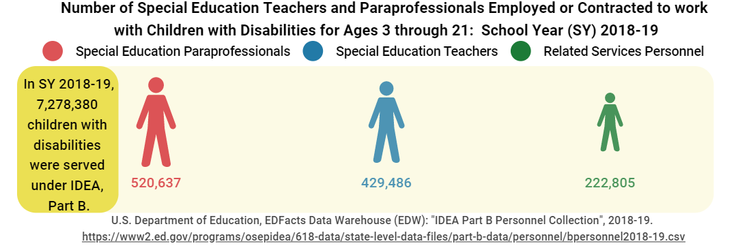
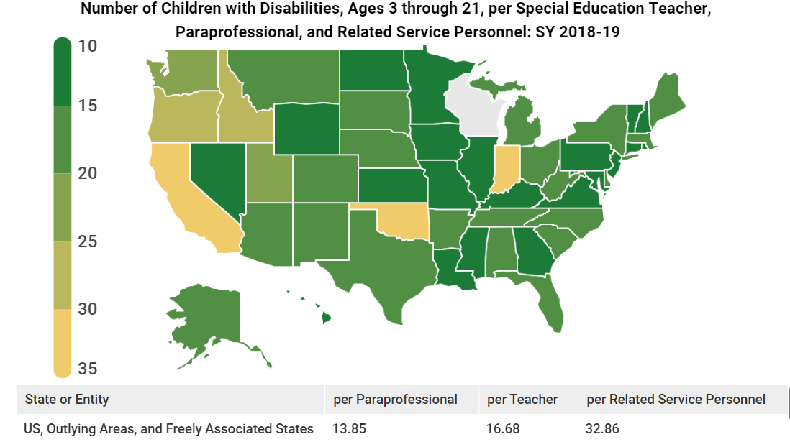
OSEP Fast Facts: Personnel (April 2021)
Notes:
https://sites.ed.gov/idea/osep-fast-facts-part-b-personnel-20/
OSEP Fast Facts: Personnel (April 2021)
Example of Data on Personnel Fast Facts shown. Other information available includes -
Number of special education teachers and paraprofessionals employed or contracted to work with children with disabilities (ages 3-21)
Number of Related Services Personnel by State
Number of teachers and paraprofessionals by qualification status in each state

Slide 16






OSEP-Funded Centers
Find an
OSEP Center
Notes:
Find A Center, https://osepideasthatwork.org/find-center-or-grant
CEEDAR, https://ceedar.education.ufl.edu/
IRIS, https://iris.peabody.vanderbilt.edu/
CIDDL, https://ciddl.org/
SISEP, https://sisep.fpg.unc.edu/
PROGRESS, https://promotingprogress.org/
NTACT, https://transitionta.org/

Slide 17


OSEP Meetings
REGISTER
Notes:
Save the Date:
For more information, visit: OSEP Meetings
https://2022osep-registration.eventfinity.co/register

Slide 18

2022 OSEP Internships
Hosted virtually
Late May – July
6-8 weeks
LEARN MORE
Notes:
Apply on USA Jobs for internships beginning in January for the following summer. For more information, email sydney.ferrell@ed.gov or one of us.

Slide 19
Updates from the Division Director
Larry Wexler
Division of Research to Practice

Slide 20

Questions I Comments I Other Ideas

Slide 21
Discussion Question
During the pandemic, what changes have you made in your educator or leadership preparation programs?
What innovations or adjustments did you make?
What will be continued?
What is needed still?

Slide 22
Discussion Question
To address personnel shortages, what changes have you made in your educator or leadership preparation programs?
What innovations or adjustments did you or will you make?
What is needed still?

Slide 23
No title

